Slide 1
Machine Learning for data science and business intelligence – 8IAR403
By Kévin Bouchard Ph.D.
Professor in artificial intelligence & machine learning
Laboratoire d'Intelligence Ambiante pour la reconnaissance d'activités (LIARA)
Université du Québec à Chicoutimi
www.Kevin-Bouchard.ca
Kevin_Bouchard@uqac.ca

Slide 2
Summary of lesson #1
You will learn about:
Content
In this lesson, we will discuss the format of the class
We will also try to define machine learning as a subfield of AI
Finally, we will end up by positionning machine learning with business intelligence and quickly explain their relations to data science
Presentation of the entire class
A brief story of yours truly
Some research projects
Machine learning in AI
Key events in AI
Data science and BI

Slide 3
Course summary
What is useful to know to follow this class?
A bit of programming, especially in Python with the main libraries (Panda, Numpy, etc.)
Basic mathematic, we’ll discuss differentials, statistics, and computational complexity
(Optional) Some culture of artificial intelligence as a field
Advices to succeed in this class
Take note during the class
Do not delay your understanding; ask questions!
Do not hesitate to look online for alternative explanations
Practice, practice, practice!
Notes:
Mentionner la philosophie, favoriser l’autoformation, cours qui vise à leur donner la compréhension des fondements théoriques

Slide 4
Course format
We have 20 classes together, 8 labs, and 2 exams
We will therefore have 20 lessons that will cover theoretical content and include simple code examples and exercices
The 8 labs will be graded, and they’ll aim to make sure you understand and follow the class
Each lab will be worth 5% of your grade
The two exams will be worth respectively 20% and 40% of your total grade

Slide 5
Course planning
Introduction
What is ML?
A review of the fundamentals
Perceptrons
Gradient training
Scitkit-Learn
Support Vector Machine
Non-parametric models
Evaluation of our models
Regression
Non-linear regression
Ensemble learning
Stacking and Boosting
Multilayer Perceptron
Dimensionality
Visualization of high dimension data
Clustering
Other types of clustering
Convolutional neural network
Recurrent neural network

Slide 6










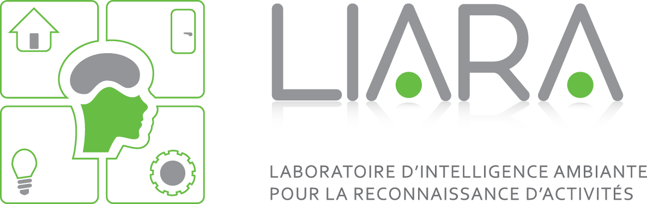
Who is your Professor?
My academic positions and diplomas
My main research interests
Invited Professor – July 2023 to Dec. 2023
Artificial Intelligence Institute, University of Waikato, New Zealand
Scientist – Oct. 2015 to August 2016
Center for SMART Health, University of California Los Angeles, CA, USA
Postdoc – Aug. 2015 to Oct. 2016
Center for Advanced Studies in Adaptive Systems (CASAS), Washington State University, WA, USA
Postdoc – July 2014 to July 2015
Domotique et informatique mobile lab (DOMUS) Université de Sherbrooke, QC, Canada
BSc, MSc, PhD – to July 2014
Laboratoire d’intelligence ambiante pour la reconnaissance d’activités (LIARA), Université du Québec à Chicoutimi, QC, Canada
Ambient intelligence
Smart homes
Smart cities
Activity recognition
Machine Learning
Data transformation
Filtering, fusion
Architectures
Industrial applications of ML
Mining
Electricity

Slide 7

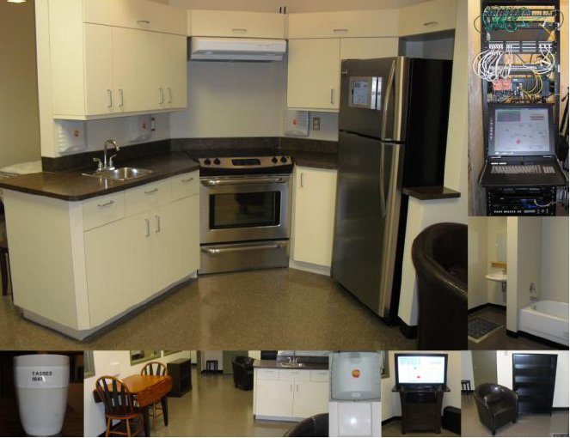

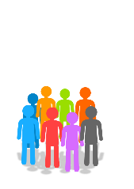
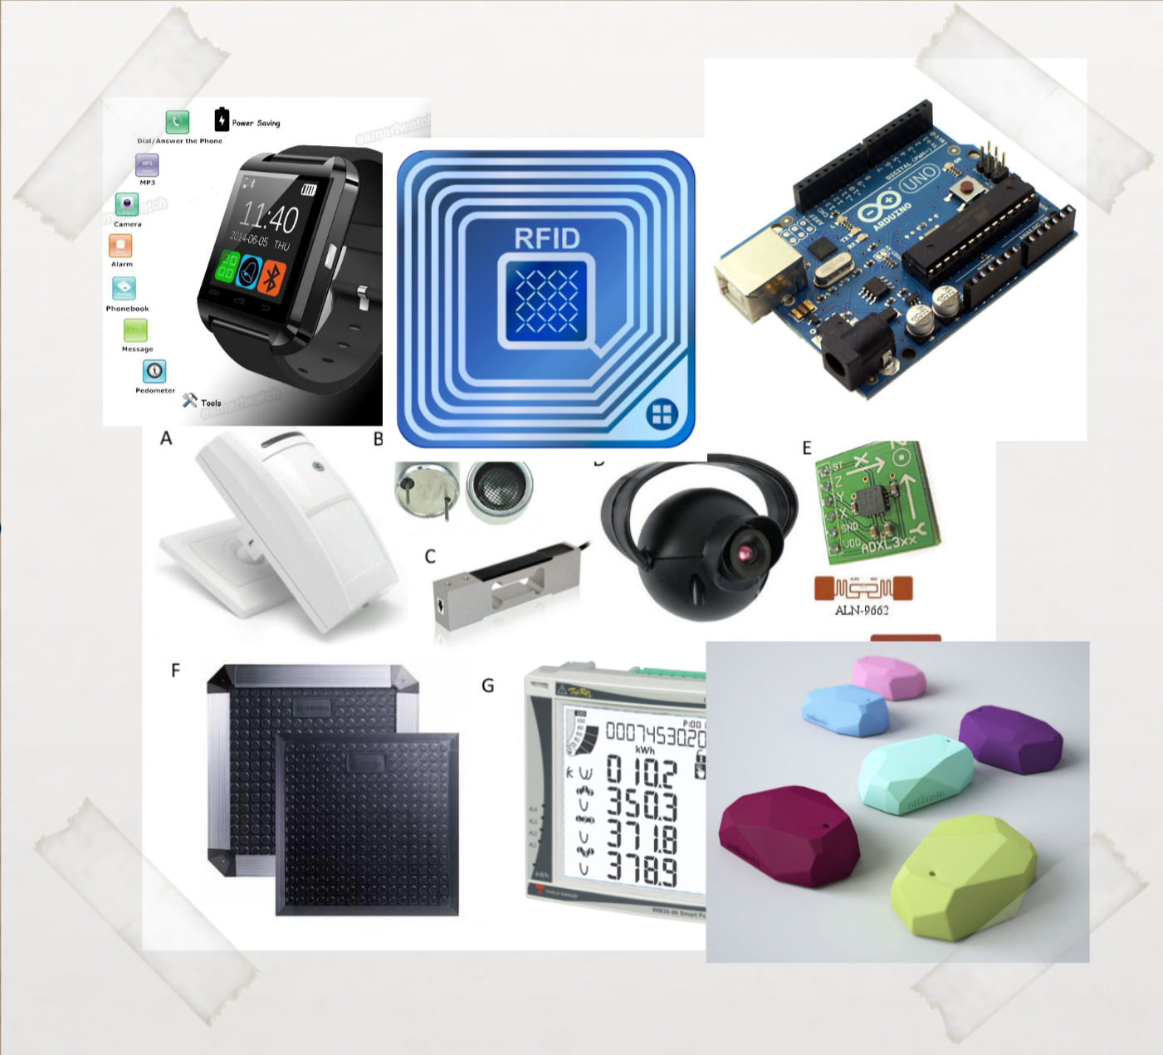


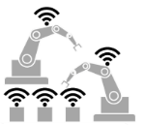
The LIARA Lab
Our expertise?
Main Partners
The LIARA lab is a prototyping lab working toward creating new technologies and algorithms for smart homes destined to age-in-place. The team creates and use all type of sensors, build small prototype, and test them with people in the UQAC’s smart home.
The best prototypes are then used with our partner universities for real-clinical trials.
6 Professors in CS
Usually around 20 active students (BSc, MSc, PhD)
We published over 250 papers in international venues
We also made several industrial partners
Notes:
Parler UdeM->Nathalie Bier… déploiements d’une trentaine d’habitats, CISSS, Berthiaume
Parler UdeS->Un labo prototype similaire,

Slide 8
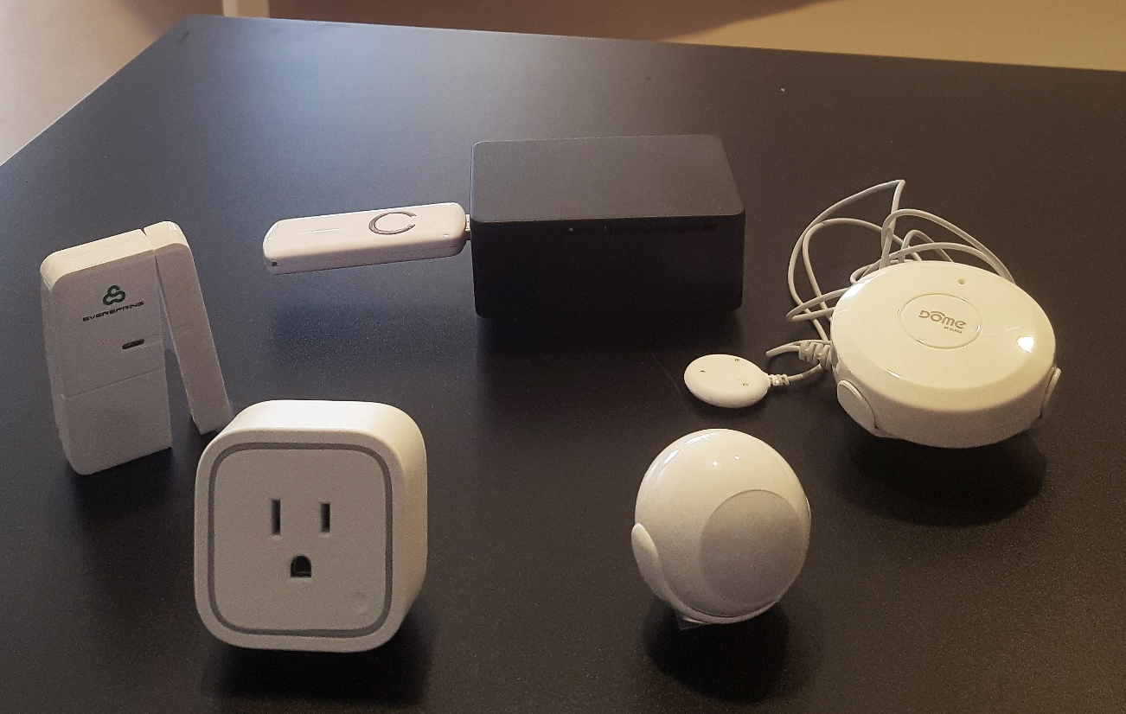






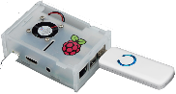
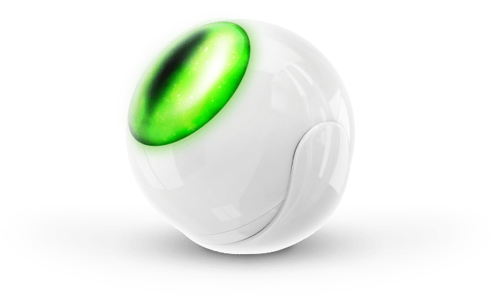

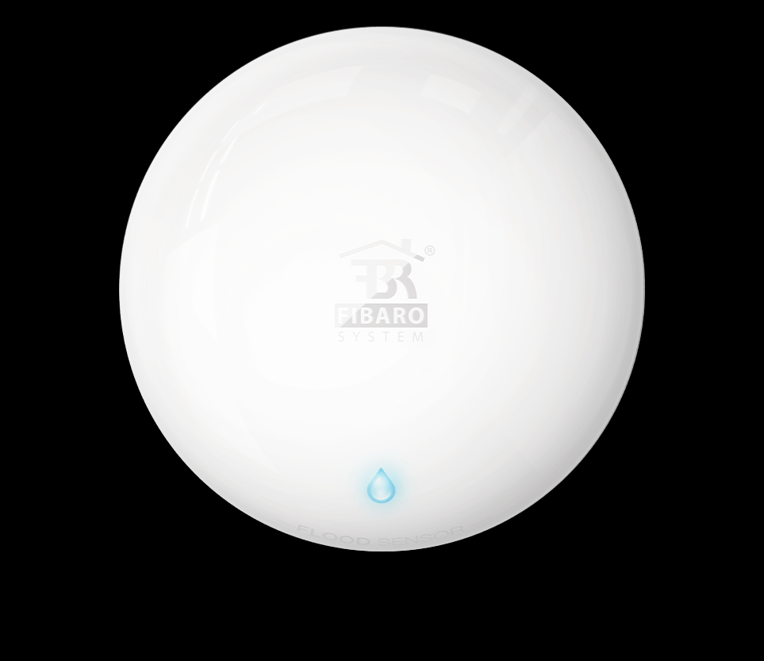

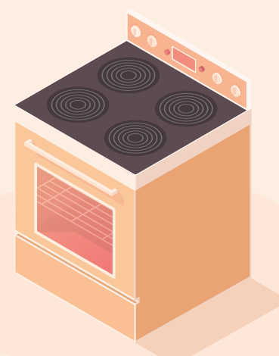
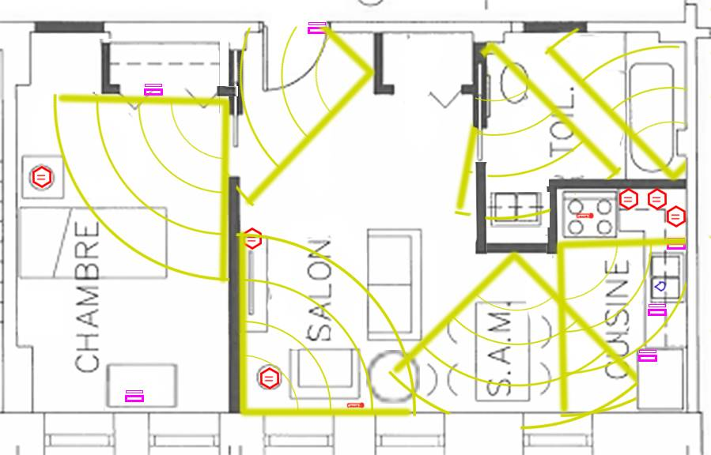

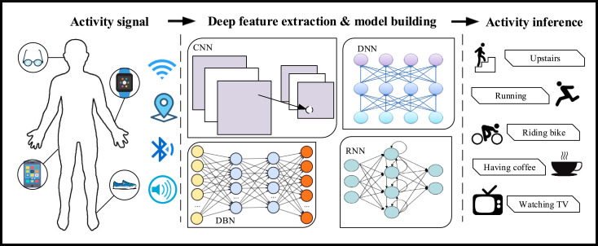
Our highest TRL smart home tech: NEARS
Mqtt
Broker
Kafka
Data digesting
Preprocessing
Sensors and computer
MongoDB
Data storage
Services and algorithms
Notes:
Expliquer le processus et nos collaborations avec les autres uni

Slide 9
+ 40 000 000 of data
40 deployed smart homes
Several others deployement
Collected in naturalistic settings!
Used for real by semi autonomous people, 70% women with dementia
Based on simple, but cheap sensors
In a smart city project->Côte-St-Luc (30 being deployed)
In 2024, if we are financed, approx. 100 accross three regions
Notes:
Avancement général
Décrire brièvement que pour l’habitat de base, nous en sommes à mesurer quantitativement

Slide 10

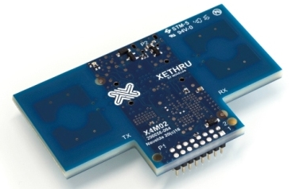
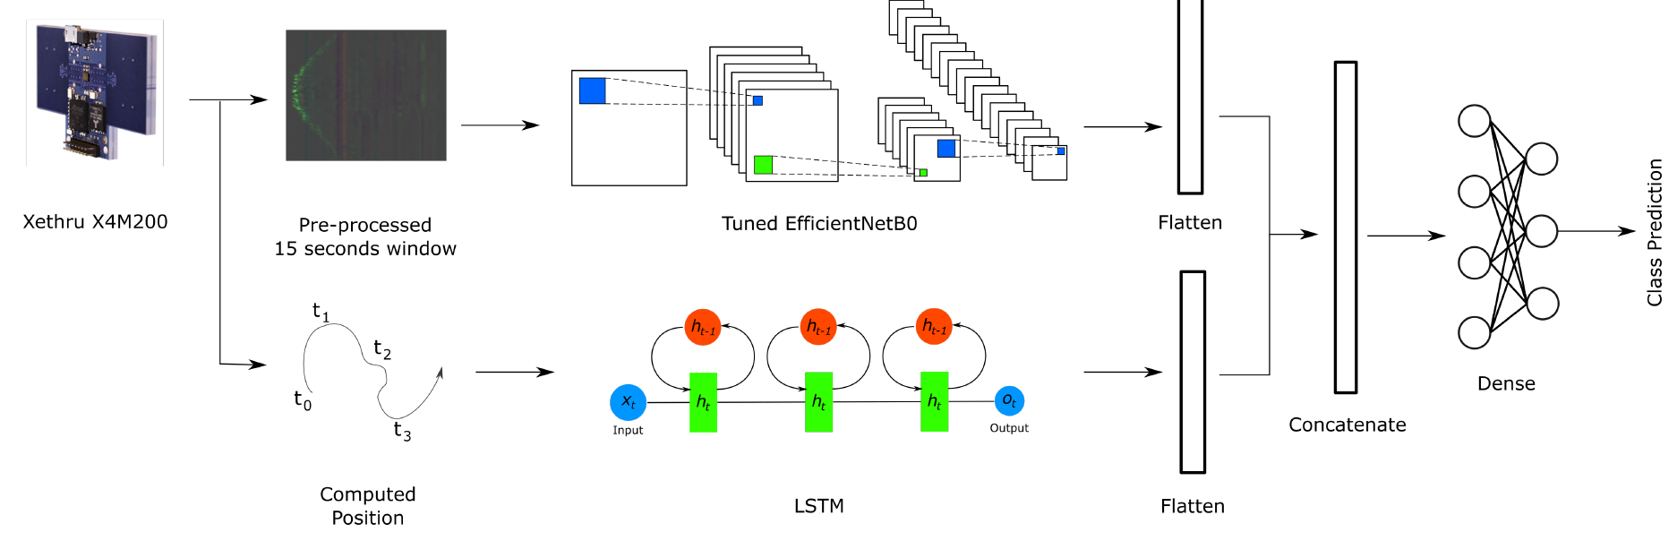
Project example: Radars UWB

Slide 11
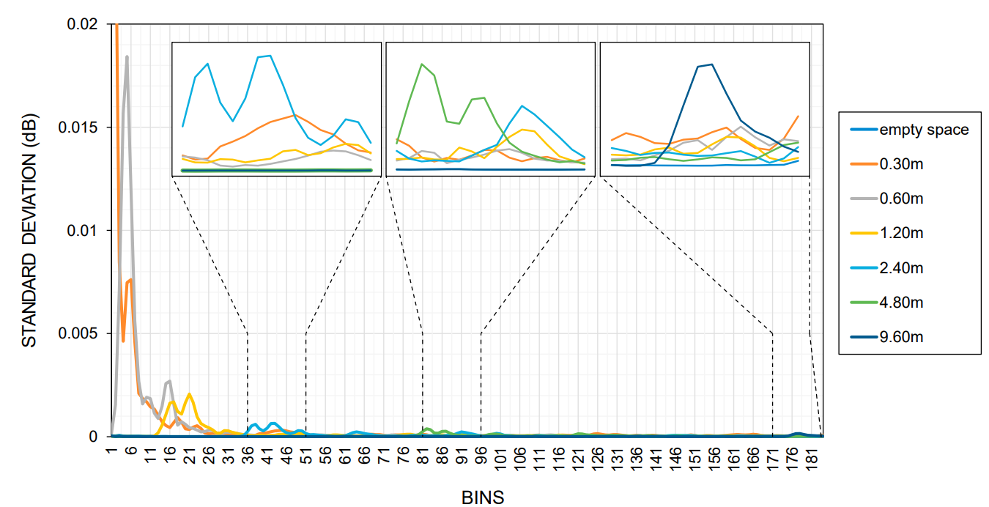
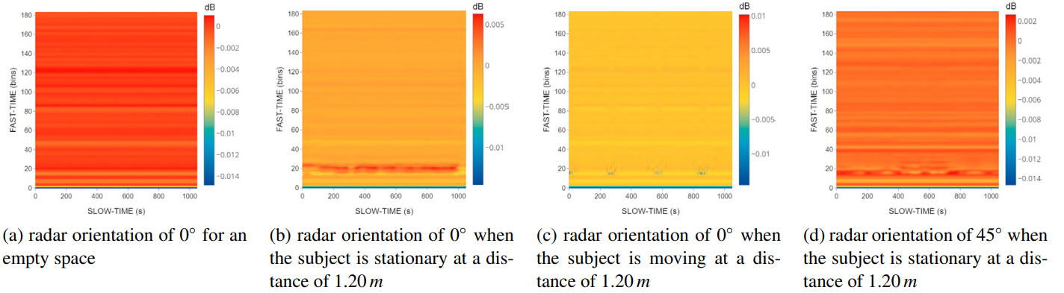
UWB data and current work
Notes:
ébruitage
Génération de trames synthétiques
3D radars vs lidar (our current work, just starting $$$)

Slide 12
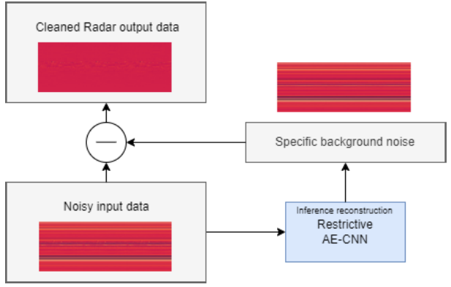
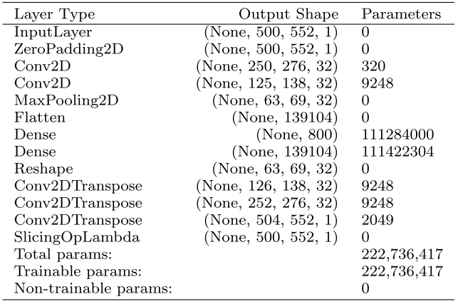
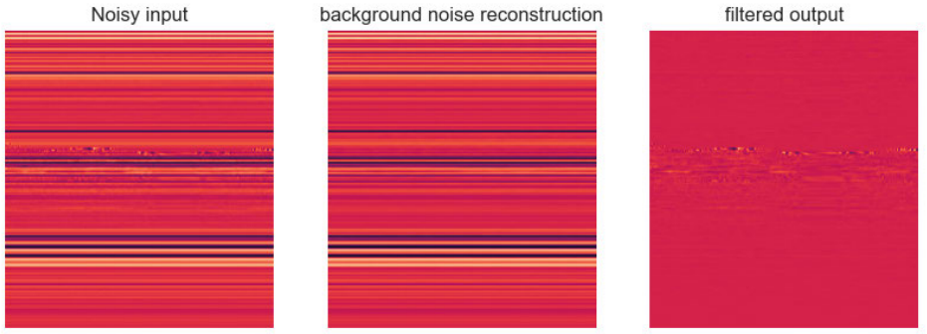
Denoising UWB automatically
Using Restrictive Convolutional AutoEncoder, it is possible to learn in a completely unsupervised fashion to denoise the data
Obviously, this is advanced ML, but will see the basic blocks leading to this in our classes

Slide 13
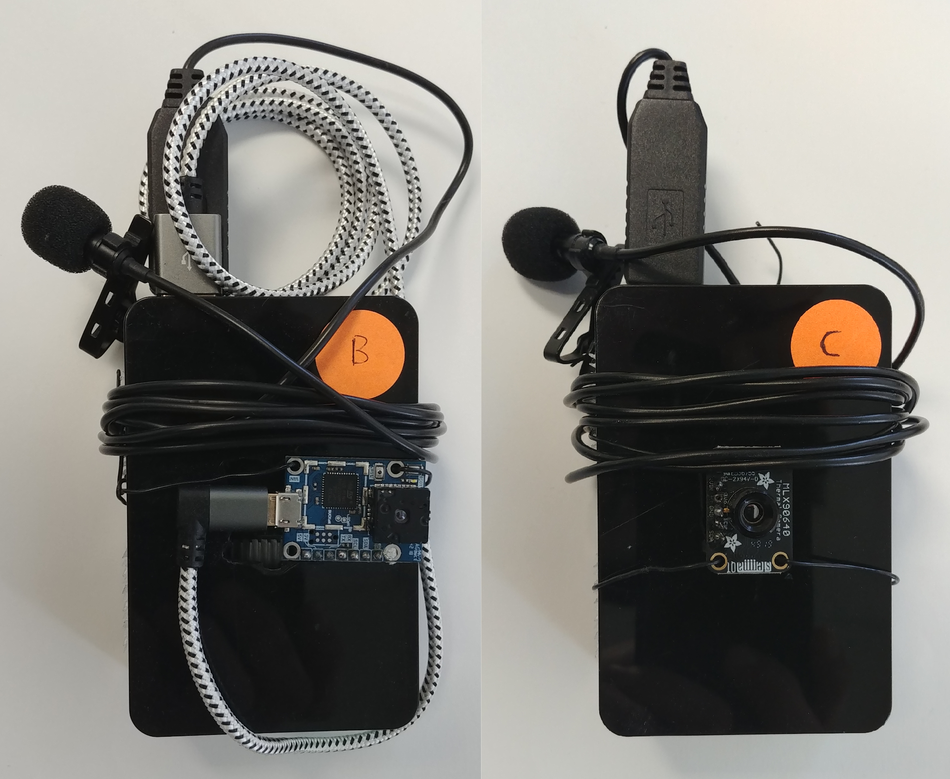
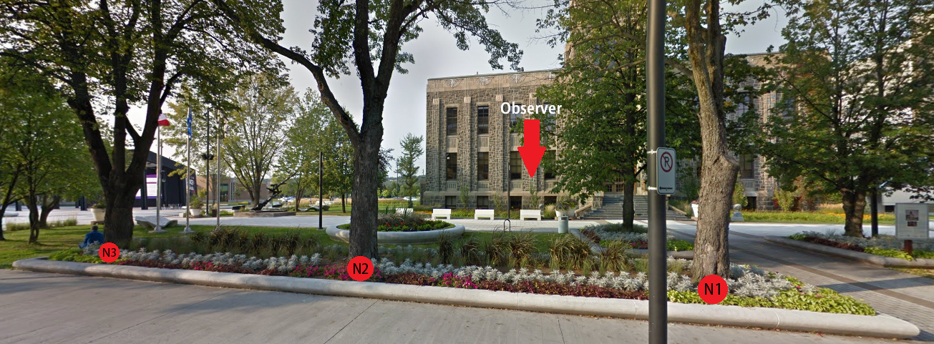
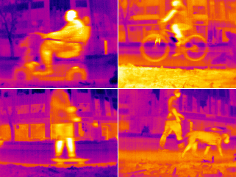
Second example: Smart Cities
Follow population in public space people without using RGB camera
Detect if elders are using the space, if there are patterns
Detect potential dangerous situations
Make the city evolve with better ground truth data (without identification)
Notes:
De façon anonymisé… mesure d’inclusion et aide à l’urbanisme

Slide 14
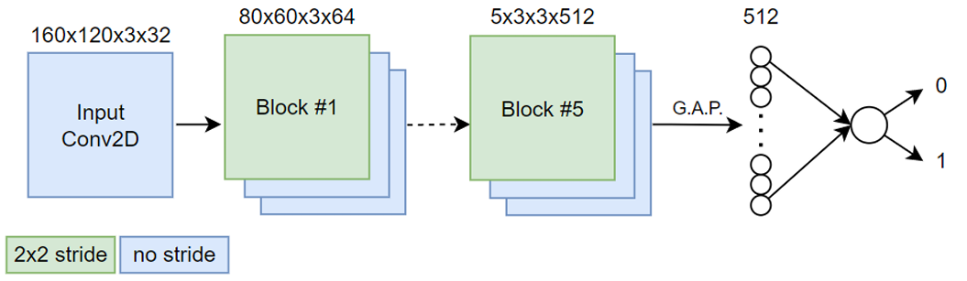
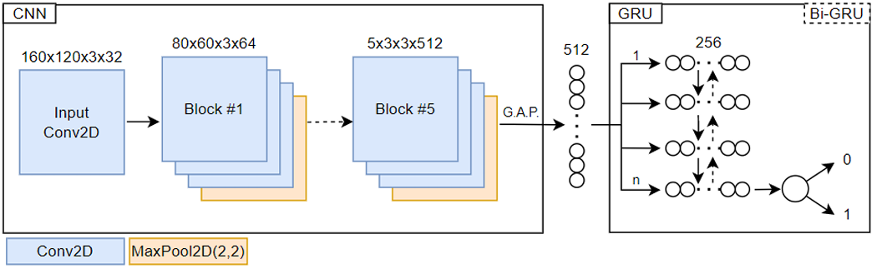
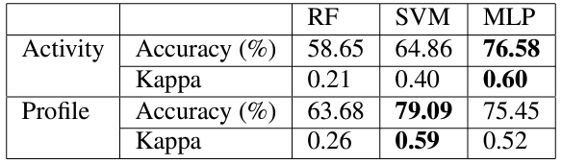
Types of models for this?
We tested classic models that we’ll see in this class
We also developped and validated hundreds of CNN and RNN
We’ll also briefly introduce their vanilla version

Slide 15
Some of my papers if you’re interested
[1] Back A., Bédard P., Maître J., Bouchard K.: From Rocks to Pixels: A Protocol for Reproducible Mineral Imaging and its Applications in Machine Learning, Minerals, MDPI, 2023.
[2] Lafontaine V., Bouchard K., Maitre J., Gaboury S. : Denoising UWB Radar Data for Human Activity Recognition Using Convolutional Auto-Encoders, IEEE Access, 2023.
[3] Maitre J., Bouchard K., Gaboury S. : Data Filtering and Deep Learning for Enhanced Human Activity Recognition from UWB Radars, Journal of Ambient Intelligence and Humanized Computing, Springer, 2023.
[4] Abudalfa S., Bouchard K.: Two-Stage RFID System for Localizing Objects in Smart Homes based on Gradient Boosted Decision Trees with Under- and Over-Sampling, Journal of Reliable Intelligent Environments, Springer, pp1-16, 2023.
[5] Beaulieu A., Thullier F., Bouchard K., Maitre J., Gaboury S.: Ultra-Wideband Data as Input of a Combined EfficientNet and LSTM Architecture for Human Activity Recognition, Journal of Ambient Intelligence and Smart Environments, IOS Press, 2022.
[6] Chapron K., Thullier F., Lapointe P., Maître J., Bouchard K., Gaboury S.: LIPSHOK: LIARA Portable Smart HOme Kit, Sensors, MDPI, 2022.
[7] Latif G., Bouchard K., MaitreJ., Bédard P.: Automatic Mineral Grains Segmentation and Recognition using Deep Learning, Minerals, MDPI, 2022.
[8] Baghezza R., Bouchard K., Bouzouane A., Gouin-Vallerand C.: Profile Recognition for Accessibility and Inclusivity in Smart Cities using a Thermal Imaging Sensor in an Embedded System, IEEE Internet of Things, 2022.
[9] Lauzier L., Kadri M.A., Bouchard E., Bouchard K., Gaboury S., Gagnon J-M., Girard M-P., Larouche A., Robert R., Lapointe P., da Silva R., Beaulieu L-D. : Vibration of the Whole Foot Soles Surface using an Inexpensive Portable Device to Investigate Age-Related Alterations of Postural Control, Frontiers in Human Neuroscience, 2021.
[10] Cousyn C., Bouchard K., Gaboury S.: Web-Based Objects Detection to Discover Key Objects in Human Activities, Journal of Ambient Intelligence and Humanized Computing, Springer, 2023.
[11] Maitre J., Rendu C., Bouchard K., Bouchard B., Gaboury S.: Object Recognition in Performed Basic Daily Activities with a Handcrafted Data Glove Prototype, Pattern Recognition Letter, Elsevier, pp.181-188 2021.
[12] Baghezza R., Bouchard K., Bouzouane A., Gouin-Vallerand C.: From Offline to Real-Time Distributed Activity Recognition in Wireless Sensor Networks for Healthcare: a Survey, Sensors, MDPI, 2021.
[13] Chapron K., Lapointe P., Lessard I., Darmstadt-Bélanger, Bouchard K., Gagnon C., Lavoie M., Duchesne É., Gaboury S.: Acti-DM1: Monitoring the Activity Level of People with Myotonic Dystrophy Type 1 Through Activity and Exercise Recognition, IEEE Access 9 (2021), 49960-49973. DOI: 10.1109/ACCESS.2021.3068877.
[14] Maitre J., Bouchard K., Gaboury S.: Alternative Deep Learning Architectures for Feature-Level Fusion in Human Activity Recognition, Mobile Networks and Applications, Springer, 2021.
[15] Demongivert C., Bouchard K., Gaboury S., Bouchard B, Lussier M., Parenteau M., Laliberté C., Couture M., Bier N., Giroux S.: A Distribuable Event Oriented Architecture for Activity Recognition in Smart Homes, Journal of Reliable Intelligent Environments, Springer, 2021.
[16] Francillette Y., Boucher É., Bouchard K., Bouchard B., Gaboury S.: Serious games for people with mental disorders: State of the art of practices to maintain engagement and accessibility, Entertainment Computing, Elsevier, 2021.

Slide 16




So, what is Machine learning?
How to define machine learning, especially in relation to AI and other fields?

Slide 17
Machine Learning
Using algorithms to learn a model about the world instead of specifying it in advance with code
It is a HUGE discipline of AI, aguably the biggest one
It includes all methods that take as input observations from the world or a virtual environment to automatically create a model
The model is not a simple remembering of observations/actions pairs, but rather a generalization of it
It even includes simple statistical model such as linear regression (not exclusive to ML of course)
Notes:
1-Qu’est-ce que l’IA-> Vision, Perception,
2-hypothèse simplificatrice sur le monde… exemple des animaux… (mammifères… chat, chien, etc.) -> certaines peuvent être erronées si pas assez de data (vie sur terre)
On veut conserver l’essentiel!
3-On vise des modèles qui généralisent bien, qui ne sont pas spécifiques à nos paramètres…

Slide 18
Unsupervised
Supervised
Vision
Robotic & Automation
Reinforcement
Classic and partial order
Machine Learning
Natural Language Processing
Perception
Plan recognition
Artificial intelligence
Search
Planning
Activity recognition
Problems Solving
. . .
Knowledge Representation
Constraints Satisfaction Problems
Recommendation systems
Ontology

Slide 19
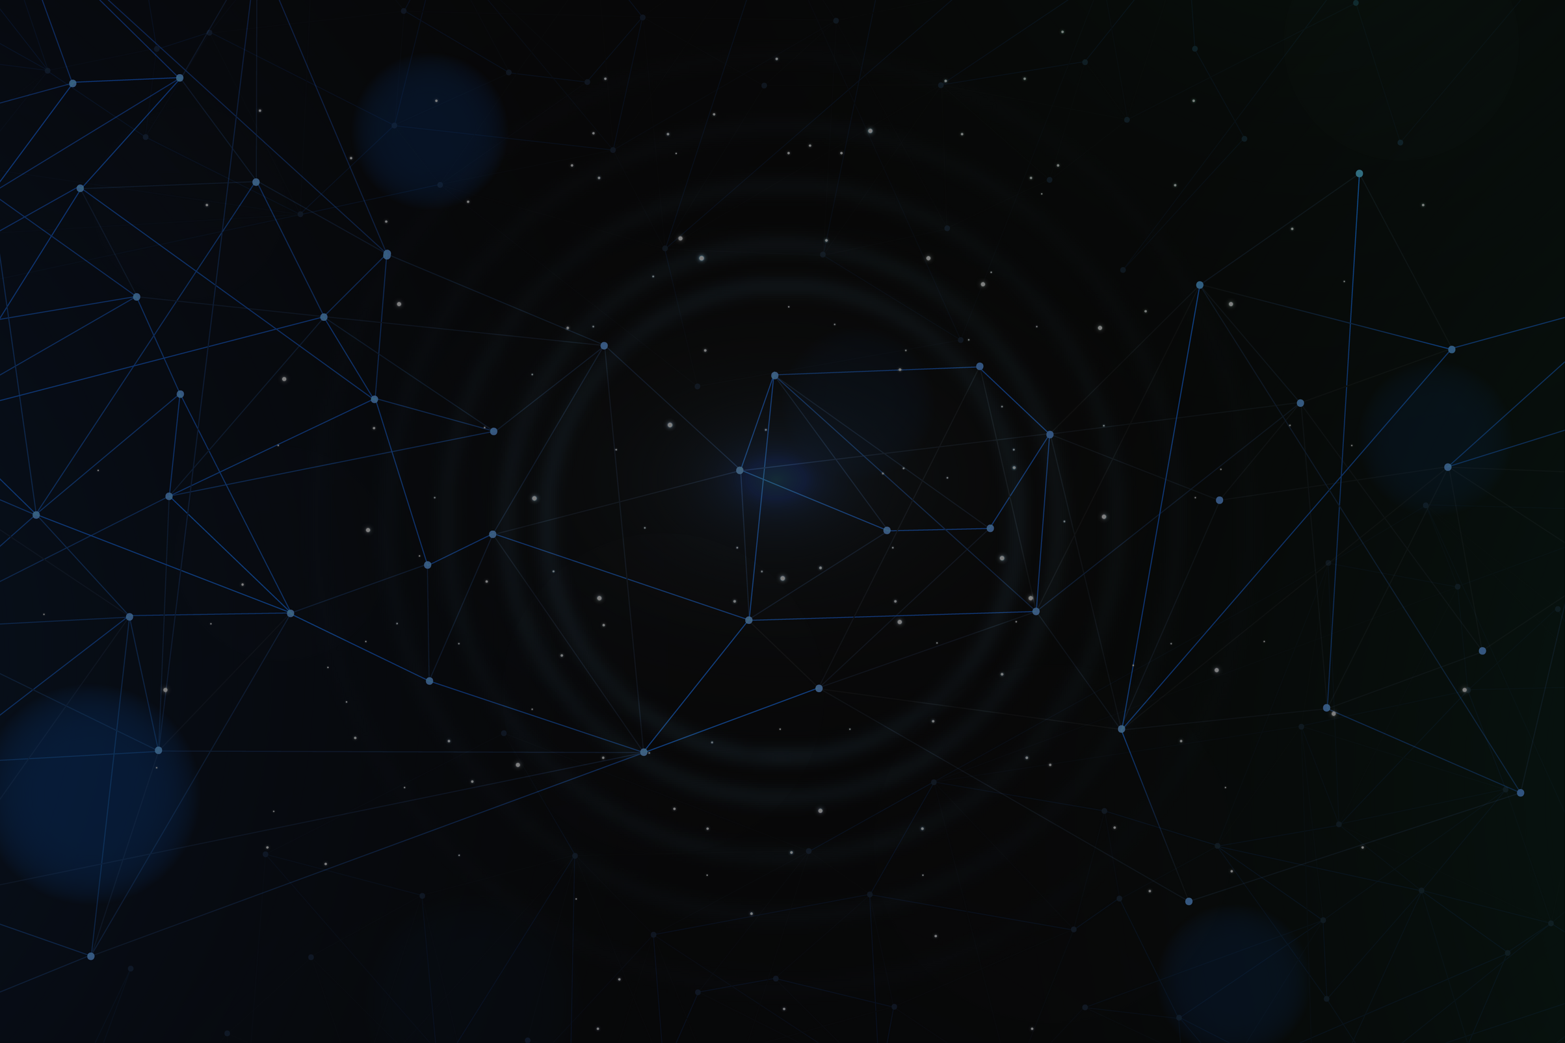
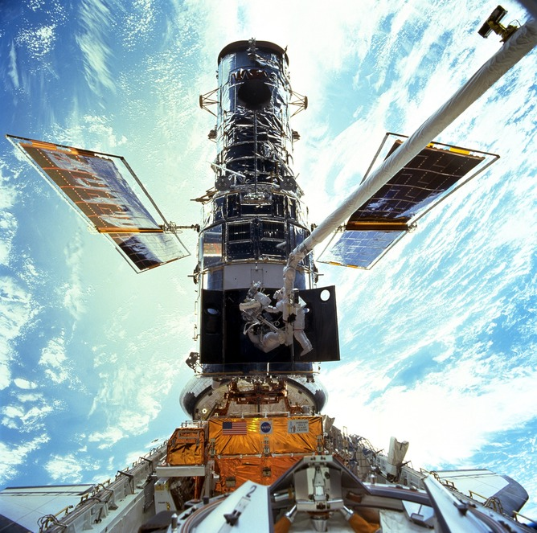
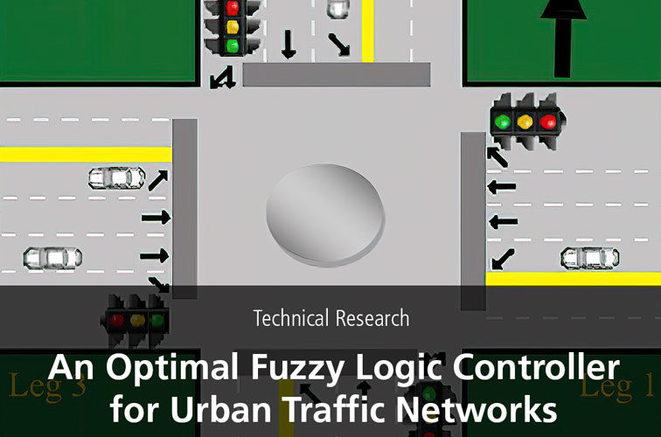
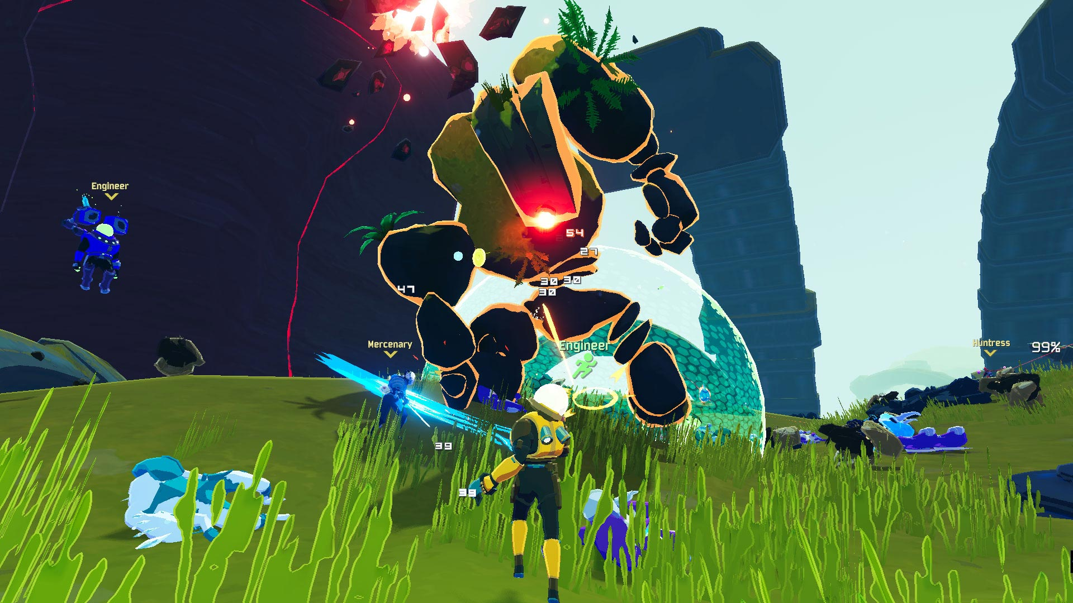
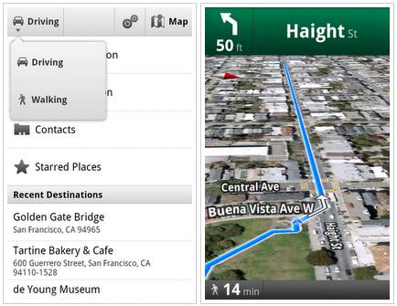
AI is more than we think!
To name a few:
Advertising, control using fuzzy logic systems, car traction control, decision support systems, recommandation systems, behaviors in games, planning in airport, insurance, etc.
Notes:
ML vs AI – fundamentally cross-sectoral and multidisciplinary... naming a few domains of prominent researchers.
A tremendous number of applications arise from work in AI – advertising, search engines, for example, fuzzy logic, through fuzzy logic controls, is used in video games, traction control, traffic control, decision support systems, household appliances, etc. Exploration is used in zero-sum games, mathematical proofs, optimization.
To state obviously, the boundary is blurry, not 100% AI, and researchers from other disciplines are working on the same subjects...

Slide 20
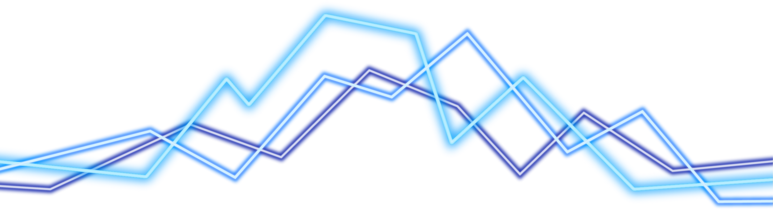
« Any sufficiently advanced technology is indistinguishable from magic. » - Arthur C. Clarke
Often we hear… this is simple, not really AI!
« AI is anything that has not been done yet. » Edward Geist, 2016
Notes:
It is the AI effect, the trend to constantly redifine AI.

Slide 21
A bit of history
First AI winter, 1974-1980
Backpropagation, 1982
Second AI winter, 1987-1995
Deep learning, 2011-
Perceptron, 1958
Turing test, 1950
GPS and logical era, 1957
Deep blue, 1997
AlphaGo, 2016
CNN, 1980
McCarty coin the term, 1956
ELIZA first chatbot, 1966
Expert systems, 1980-1986
Big generative AI, 2020
Alpha-beta, 1959
Book on Perceptrons, 1969
Probabilistic AI, 1988
Autonomous car, 2005
Notes:
GPS – an algorithm from Aristotle, 2300 years later, now named regressive greedy planning. A-B-playing checkers, the fundamental basis for opponent exploration. Expert Systems – A billion-dollar industry. Probabilistic reasoning published by Pearl at the same time as the return of neural networks. Deep Blue - 2 victories, one defeat, 3 draws... now seemingly simple.
Talk about the trend from knowledge driven to datadriven
Minsky 1966 – Deep learning is too difficult to train, death of neural net!

Slide 22
Justification for Data driven AI?
How come AI switched from knowledge driven towards data driven?
There are several reasons most researchers turned their back on knowledge driven approaches, here are the main ones:
It is often very difficult, if not impossible to codify human expertise
While some tasks requiring intelligence are easily described (e.g.: how to diagnose a car problem, how to recognize an activity from high-level actions, etc.)
Some are very challenging to describe despite their natural simplicity for us (e.g.: recognizing the specific voice of a person, catching an egg without breaking it, etc.)

Slide 23
Justification for Data driven AI?
Some environments are unknown or partially known
A robot exploring a new building
An agent playing a complex video game
We sometime want our program to change, improve, or adapt over time
An agent playing a multiplayer game online
A system monitoring and predicting the stocks market (non stationary time-series)
Basically, data-driven, through machine learning enable the programming to change and adapt, yet without requiring a massive expertise such as in knowledge driven AI!

Slide 24
Comparison of AI approaches
Coded manually
Input
Coded inference
Output
Rules based AI
Input
Output
Automated association from input to output
Manual data preprocessing
Classic ML
Input
Coarse features
Output
[many refinement layer]
Complex features
Automated association from input to output
Deep Learning

Slide 25
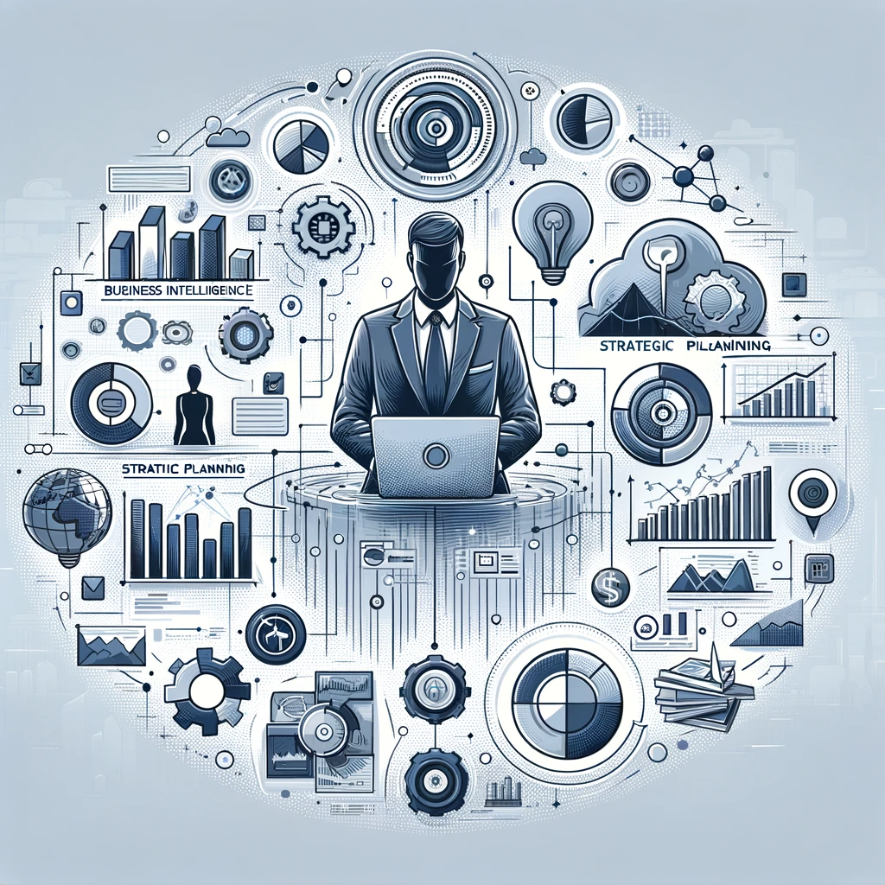

Business intelligence
This course also focus towards business intelligence (hereafter BI)
BI is primarily concerned with the transformation of raw data into meaningful and actionable insights for business purposes
It includes data analysis, data visualization, and reporting
But of course, data mining and more generally machine learning
This goes right into the heart of what we’re studying together!
Notes:
Tell them they’ll see visualization in 8INF418 and that they should have the tools to do simple analysis

Slide 26
BI and ML
BI and ML are closely related yet distinct fields that increasingly intersect in modern business applications
They both existed as separated entity for some time
One was for improvement of business, the other for scientific purposes
Now, ML aids BI by processing vast amounts of data more quickly than humans could, thereby generating actionable insights with greater efficiency
Common examples of use are:
Predictive models to forecast future trends in the business (e.g.: demand and sales, creditworthiness, marketing, etc.)
Fraud detection and prevention in finance (e.g.: abnormal user behavior, risk scoring, etc.)
Enhanced customer experience (e.g.: Q&A chatbots, personalized suggestions, etc.)
Notes:
Ok, but what about data science? Talk to them a bit about it… basically the computer science side of BI

Slide 27
Main references
Russell S., Norvig P., Artificial Intelligence: A Modern Approach. Prentice-Hall, Englewood Cliffs, 2021.
Aggarwal, C. C., Neural networks and deep learning. Springer, 2023.
Goodfellow I., Bengio Y., Deep Learning. The MIT Press, 2016.
Raschka S., Python Machine Learning, Packt Publishing, 2015.
Sutton R.S., Barto A.G., Reinforcement Learning: An Introduction, A Bradford Book, 2021.
Witten I.H., Frank E., Hall M.A., Pal C. Data Mining: Practical Machine Learning Tools and Techniques, Morgan Kaufmann, 2016.

